Slide 1
Evidence Acquisition and Reports
Cybersecurity
Lesson 21.4

Slide 2

Learning Objectives
By the end of today’s lesson, you will be able to:
1
Use Autopsy to view and gather evidence from Peter’s emails.
2
Use data exports to analyze email messages offline
3
Use data exports to analyze SMS messages offline.
4
Use Autopsy to extract GPS data and identify Wi-Fi locations.
5
Prepare a preliminary report using evidence worksheets.

Slide 5

Recap
In the last lesson, we covered:
01
Identifying methods used in smartphone forensics.
02
Examining databases and file structures of an iPhone directory image.
03
Locating and documenting evidence of ownership for an iPhone image.
04
Using Autopsy to view and tag evidence of an iPhone image.
05
Extracting data for use in other applications (logs, text, pictures, video, audio).

Slide 6

Overview

Slide 7
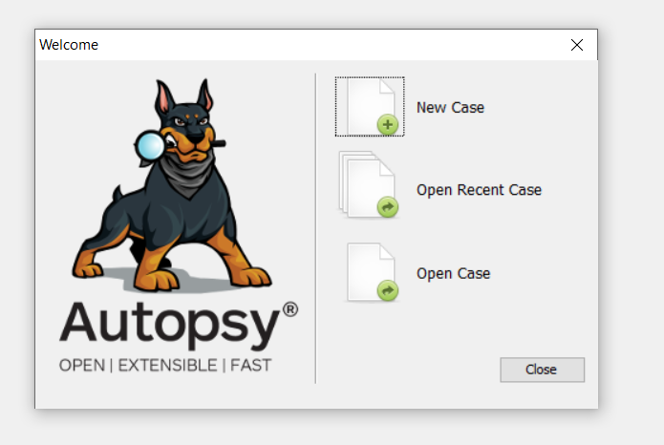
Overview
As a digital forensics investigator, it’s critical that you understand how to use tools such as Autopsy and how to export data so that other team members can perform offline analysis of evidence.
Source: sleuthkit.org

Slide 8
.emlx is a file extension
called Mail Message
that is used to store
email messages.

Slide 9


Overview
EMLX files are often referred to as Apple Mail files because they are created with Apple’s mail program to store plain text files for a single message.
EMLX

Slide 10

Email export
In this activity, you will continue your role as a digital forensics investigator.
Your task is to export the email database for offline analysis using examination tools outside of Autopsy.
15 minutes

Slide 13

Peter’s Email Evidence

Slide 14
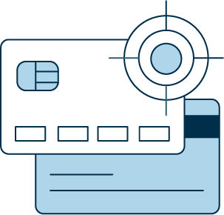
Now we’ll use offline analysis to uncover
details about the plot
of the crime and possibly identify the co-conspirators and their roles.
Notes:
shutterstock_167974337

Slide 15

Email Evidence
We can extract the following evidence from emails:
Sender’s email address
Sender’s IP address
Internet service provider (ISP)
User client (email app)
Location information
Notes:
shutterstock_1171657165

Slide 16

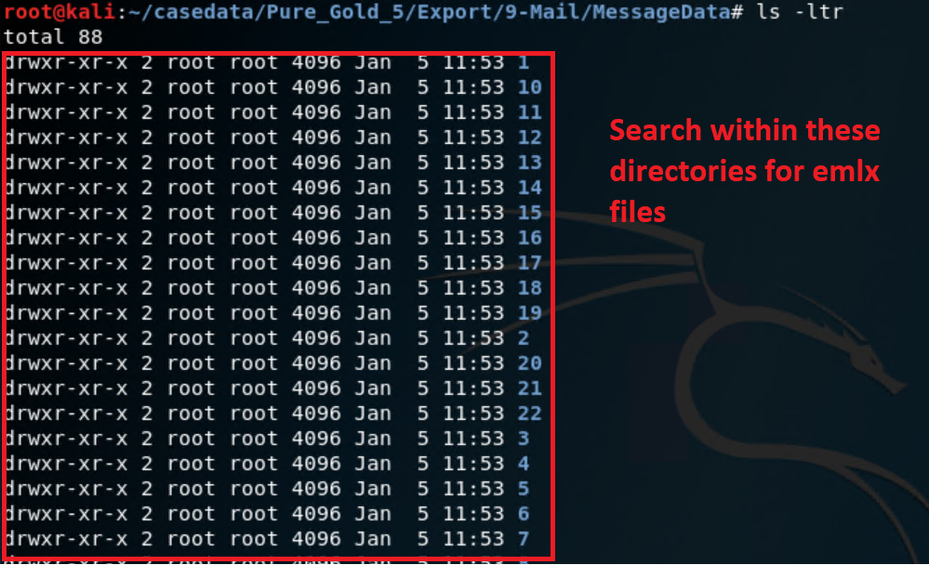
Examining Emails in Kali Linux
Displaying email messages in the Mail/MessageData folder is as simple
as running the ls -l command. From there, we’ll use nano to display the contents of each EMLX file.
Source: offensive-security.com

Slide 17
Examine emails in Kali Linux

Slide 18
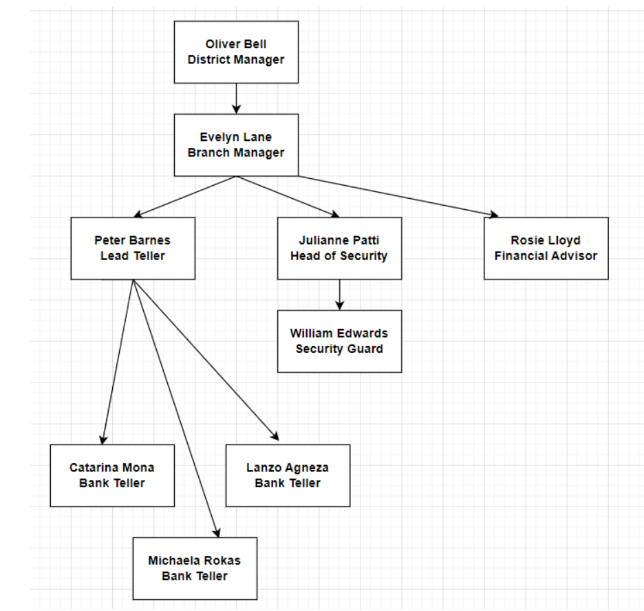
Evidence in the Emails
This diagram provides a high-level overview of the threat actors’ involvement in the Pure Gold Credit Union case. As you analyze the emails, use this as a road map to tie Peter’s associates to each incident.
Oliver Bell
District Manager
Evelyn Barnes
Branch Manager
Peter Barnes
Lead Teller
Julianne Patti
Head of Security
Rosie Lloyd
Financial Adviser
Catarina Mona
Bank Teller
Michaela Rokas
Bank Teller
Lanzo Agneza
Bank Teller
William Edwards
Security Guard

Slide 19
Correspondence Evidence Worksheet
In the next activity, you will use the Correspondence Evidence Worksheet to document evidence from the communications found on Peter’s phone (i.e., phone calls, emails, text messages).
You will fill out the following information:
Artifact numbers to help organize records | Number each record as you enter it into the worksheet.
Timestamp | The time the email was sent or received.
Header information | These should include names of the individuals involved, their email addresses, and the email subject line.
Key information | A summary of the email contents.
Evidence location | The data source (e.g., email, SMS, phone call, etc.).

Slide 20
Peter’s email evidence
In this activity, you will continue your role as a digital forensics investigator and dig deeper into the iPhone image to find more information about Peter’s involvement in the crime.
45 minutes

Slide 24

Peter’s SMS Messages

Slide 25

We’ll continue to search for more evidence by examining Peter’s SMS messages.

Slide 26
Forensic analysis of SMS messages

Slide 27
Peter’s SMS messages
In this activity, you will work with your group to examine Peter’s
SMS messages and gather more information about the case.
15 minutes

Slide 30
The final report
In this activity, you will start preparing a report of your group’s findings. You will continue this report as part of your challenge.
25 minutes

Slide 34
Module Recap
We’ve examined a lot of information and done the following:
01
Performed mobile forensics analysis and compiled details of
Peter’s iPhone.
02
Searched through numerous files and directories on the iPhone image.
03
Tagged and categorized evidence relevant to the case.
04
Created custom tags.

Slide 35
Module Recap
We’ve examined a lot of information and done the following:
Extracted data for offline analysis using the export function.
Examined and documented Peter’s emails.
Examined and documented Peter’s SMS messages.

Slide 36
Lesson Wrap-Up
Key takeaways from this lesson
Digital forensics
is a field dedicated
to identifying, extracting, preserving, and reporting against information obtained from computer and network systems.
Digital forensics
relies on the expertise
of examiners to analyze and interpret data retrieved by trusted digital forensics examination tools.
Investigative teams may be spread across several times zones,
so it's important to follow a baseline time zone as indicated by case file.

Slide 37
You’ll continue your report and work on another bonus assignment for this week’s challenge.

Slide 39
Introduction to security within the organization

